Slide 1

Employee Leave Management System
Roll no:-2335
2338
2345

Slide 2
Welcome to the presentation on our Employee Leave Management System. Streamlining leave processes for efficient workforce management.

Slide 3
Overview of the system:
Allows employees to apply for leave.
Enables admin to manage leave requests and employee profiles.
Efficient leave management ensures smooth operations.
Enhances productivity and employee satisfaction.

Slide 4
Technologies Used:
Frontend: HTML (Hypertext Markup Language) is the standard markup language for creating web pages, defining the structure and content of a webpage. CSS (Cascading Style Sheets) is used to style the HTML elements, controlling the layout, colors, fonts, and overall presentation of the web page.
Backend: PHP (Hypertext Preprocessor) is a server-side scripting language used for developing dynamic web applications. In the context of XAMPP, PHP interacts with the MySQL database and processes data to generate dynamic content for web pages.
Database: MySQL is a popular open-source relational database management system, widely used for storing and managing structured data. It provides robust features for data storage, retrieval, and management, making it suitable for various web applications.
Database Management Tool: phpMyAdmin is a web-based graphical user interface (GUI) tool for managing MySQL databases. It provides a user-friendly interface for administering databases, executing SQL queries, and performing tasks such as database creation, table management, and user permissions.

Slide 5
System Architecture
Client-side:
User interface developed using HTML, CSS, and JavaScript.
Server-side:
PHP scripts handle logic and interactions with the database.
Database:
MySQL database stores the data.

Slide 6
Key Features of the System
Employee Portal:
Apply for leave, view leave history.
Admin Portal:
Manage leave requests, approve/reject leave, add employees, departments,leave reasons,employee list.

Slide 7
Admin Portal Features
Manage Leave Requests:
Review leave requests submitted by employees.
Approve or reject leave requests based on company policies.
Add New Employees.
Enter details of new employees into the system.
Manage Departments:
Add, edit, or delete department information as needed.

Slide 8
Leave Approval Workflow
Employee submits leave request.
Admin receives notification.
Admin reviews and approves/rejects the request.
Employee notified of the decision.

Slide 9
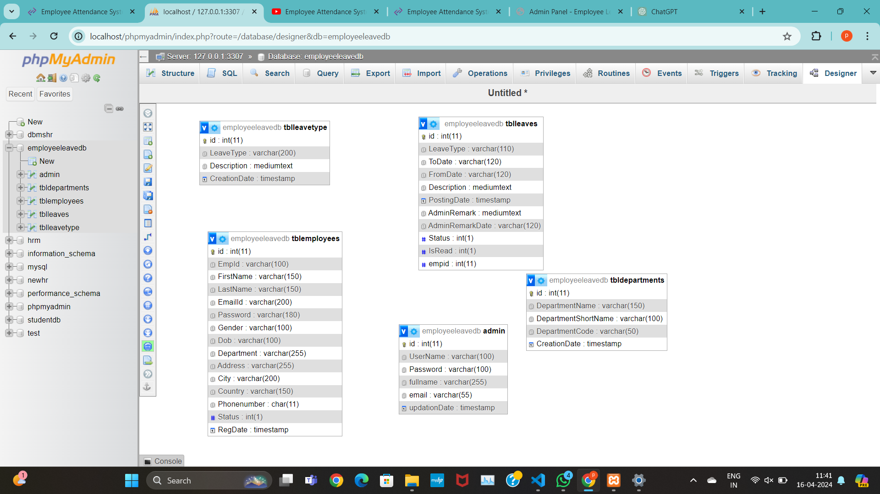
Database Schema

Slide 10
Security Measures
User Authentication
Only registered users can access the system.
Users are required to authenticate themselves using credentials (username and password) before accessing any features.
Password Hashing
Passwords are securely stored in the database using hashing algorithms such as encrypt.
Hashing transforms user passwords into irreversible strings of characters, making it computationally infeasible for attackers to reverse engineer passwords from stored hashes.

Slide 11
Benefits
Streamlined Leave Management:
Automate leave request process, reducing paperwork and administrative burden.
Improved Decision-making:
Access to real-time leave data helps in better resource planning.
Enhanced Employee Satisfaction:
Transparent and efficient leave process improves employee experience.

Slide 12
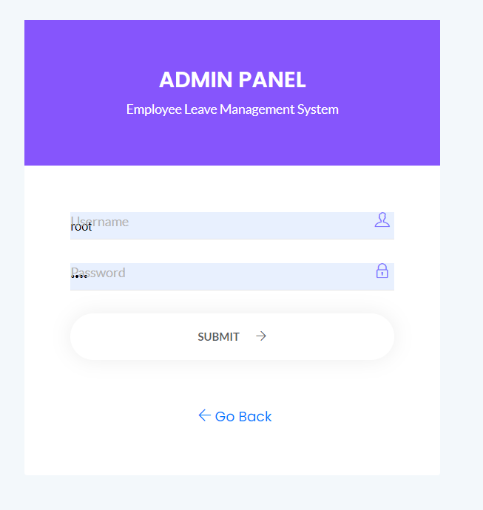
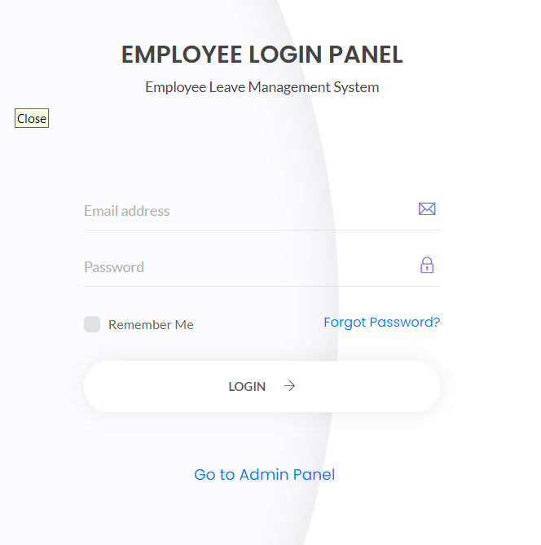
User Interface Screenshots

Slide 13
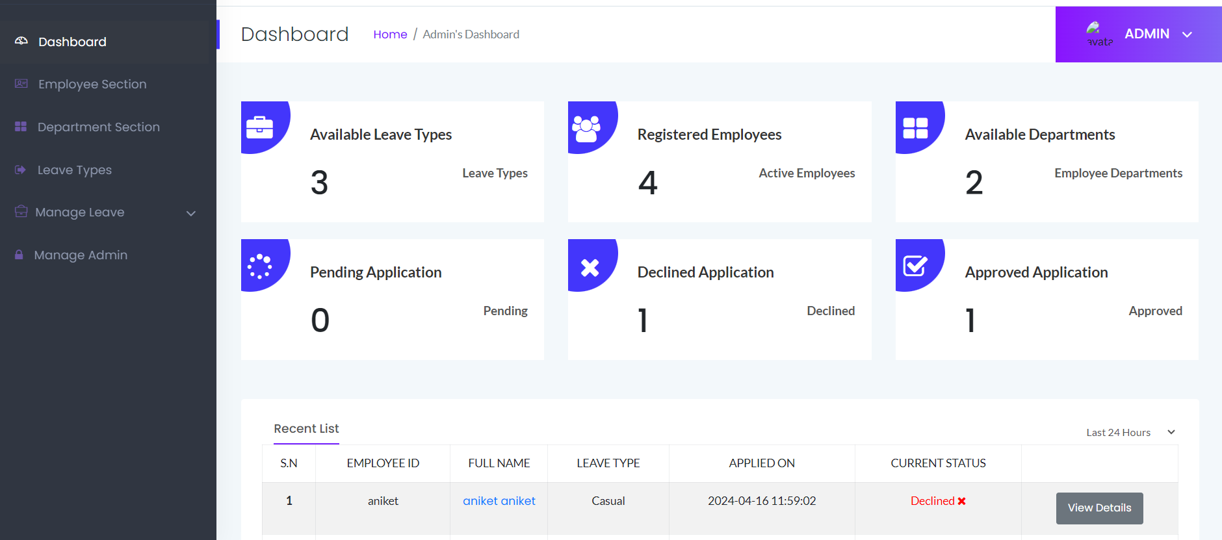
DASHBOARD

Slide 14
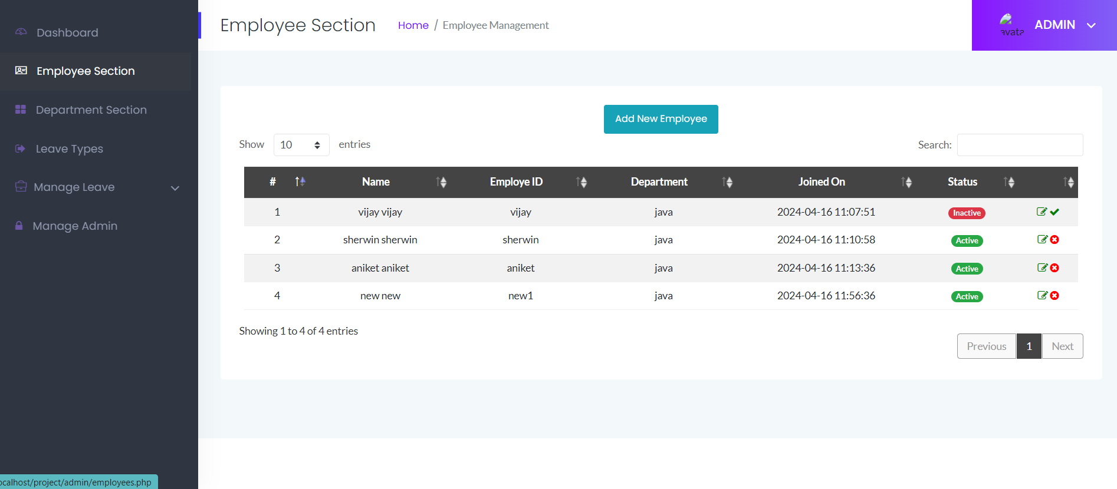
EMPLOYEE SECTION

Slide 15
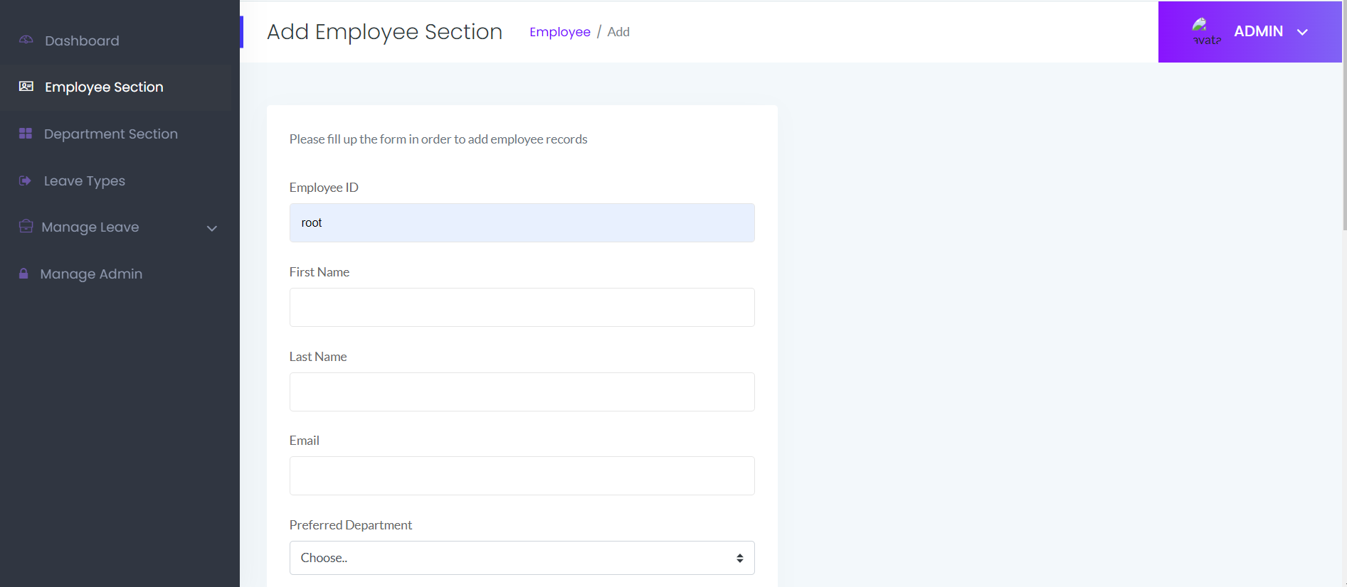
ADD EMPLOYEE SECTION

Slide 16
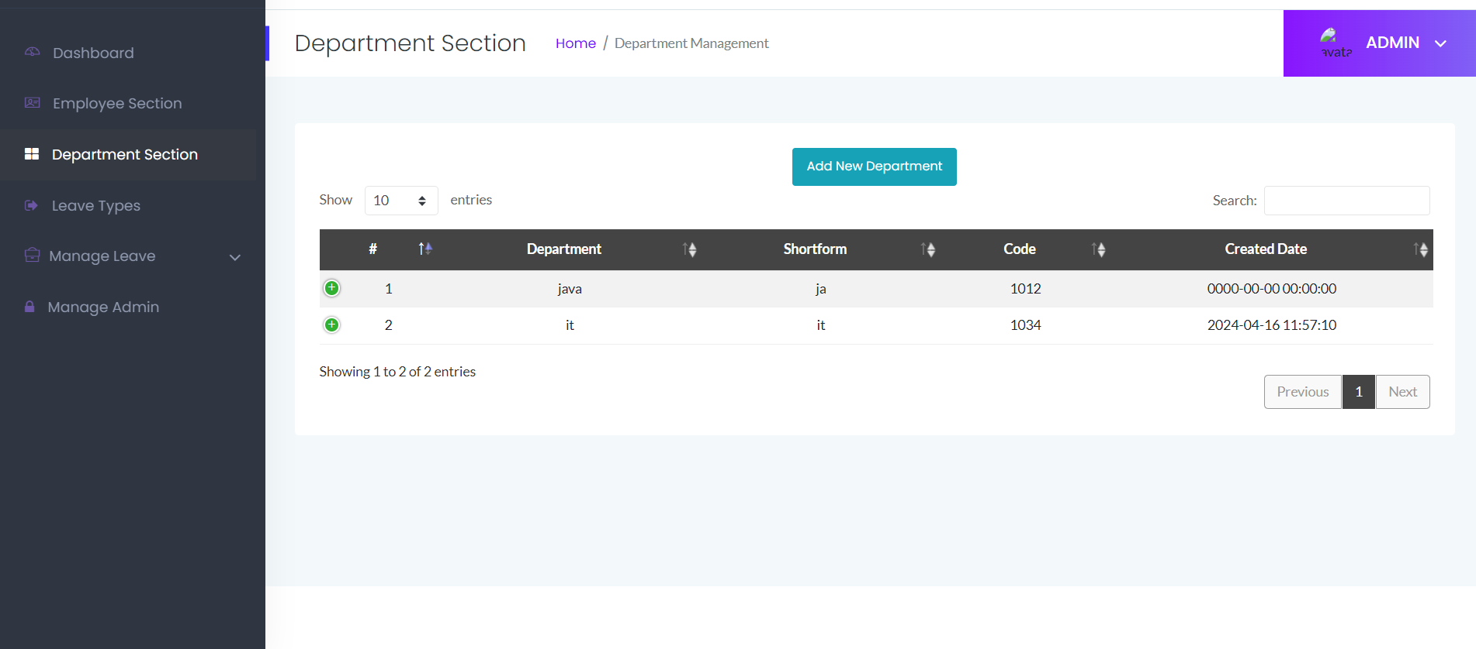
DEPARTMENT SECTION

Slide 17
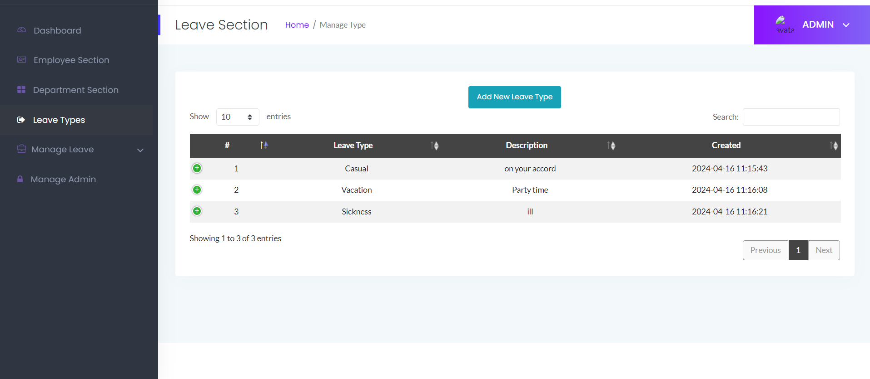
LEAVE SECTION

Slide 18
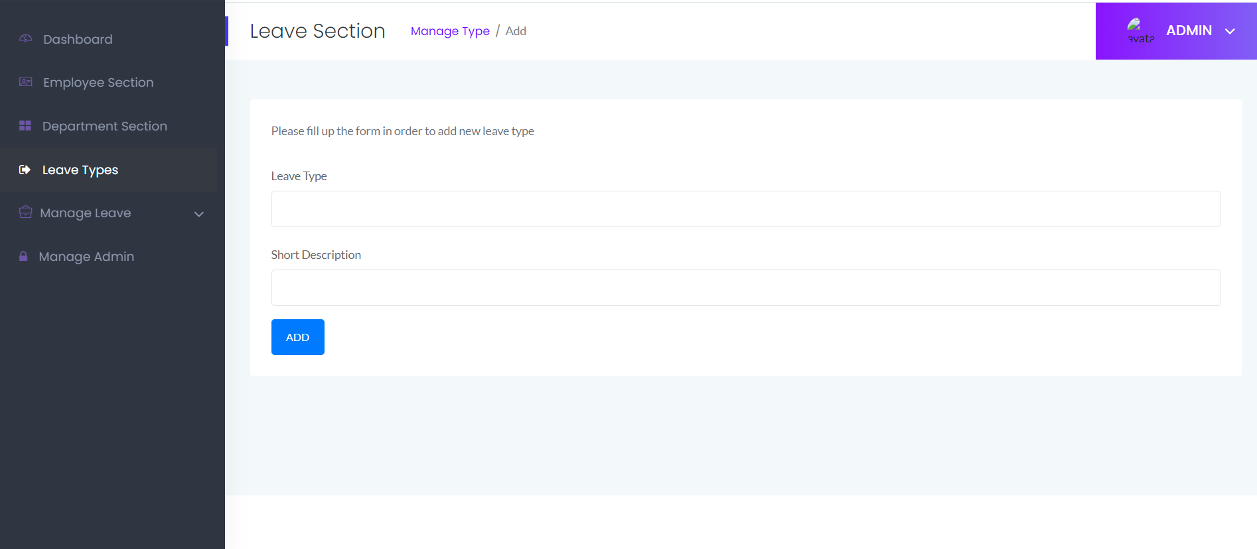
LEAVE TYPES

Slide 19
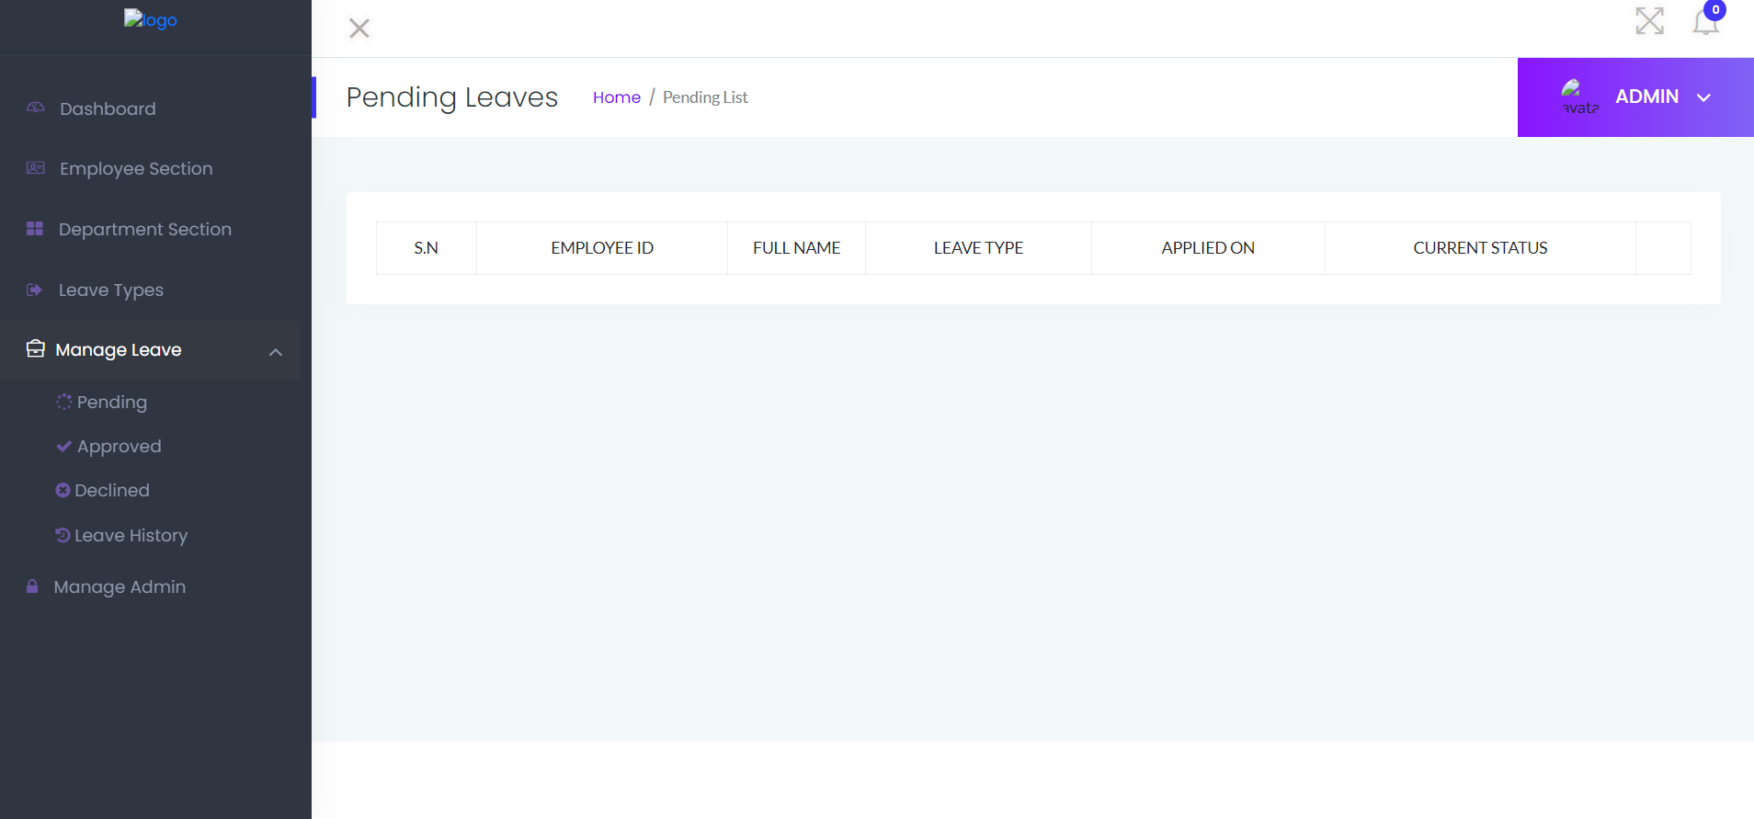
PENDING LEAVES

Slide 20
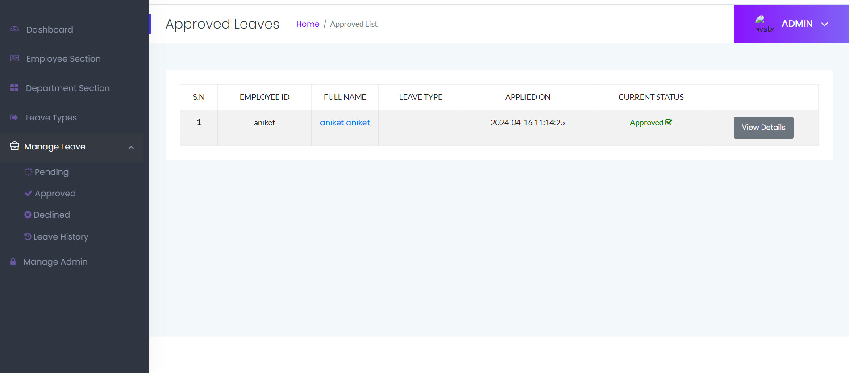
APPROVED LEAVES

Slide 21
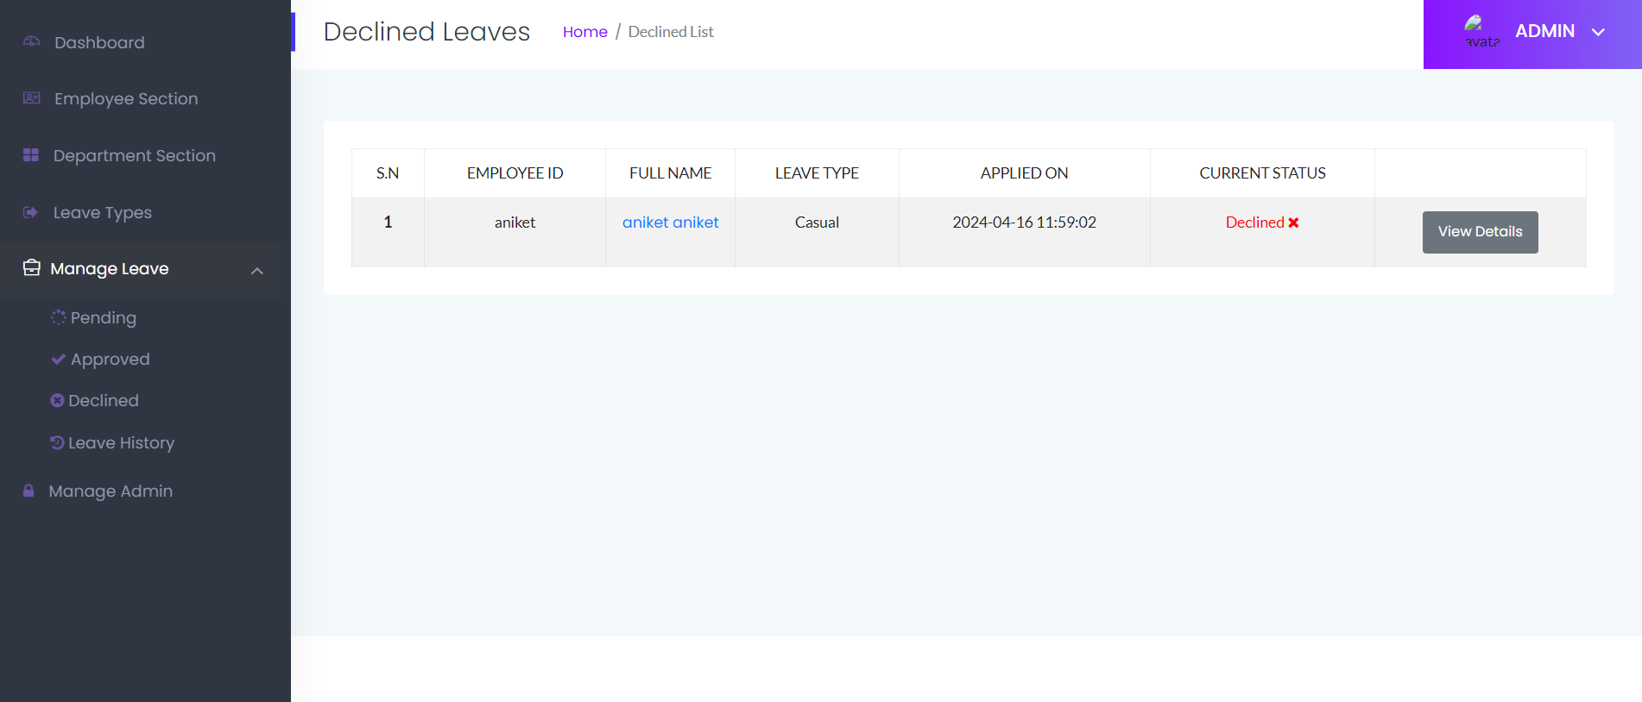
DECLINED LEAVES

Slide 22
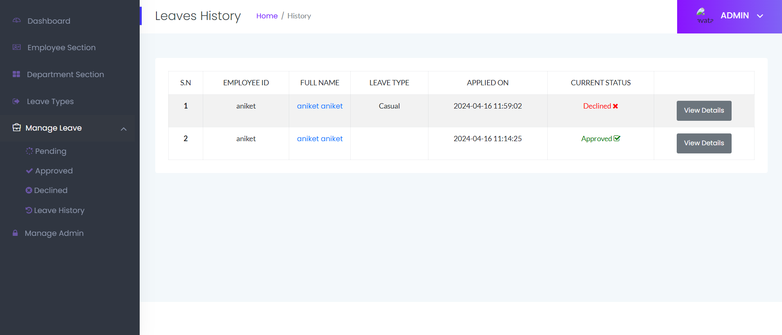
LEAVES HISTORY

Slide 23

ADMIN SECTION

Slide 24
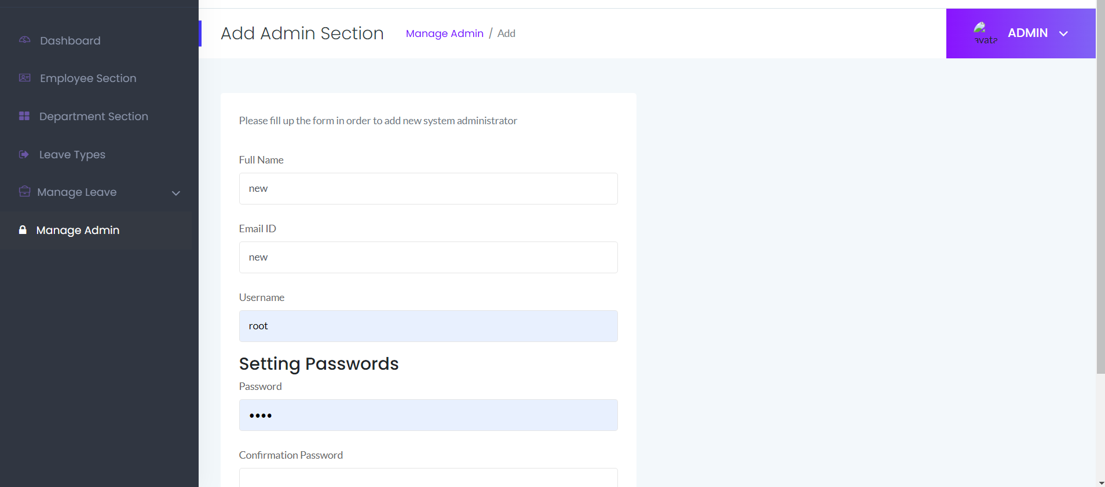
ADD NEW ADMIN

Slide 25
Thank you

